Slide 1
MODULE II: TURKISH REPUBLIC AFTER ATATÜRK: MULTI PARTY SYSTEM AND ITS CHALLENGES [1939-1980]

Slide 2
TurkIsh ForeIgn PolIcy 1923-1945
«Peace at home, peace abroad.»
Mosul Issue
1932-Turkey became a member of League of Nations
1930’s-Regional Alliances
Balkan Pact (1934)
Montreux Convention (1936)
Sadabad Pact (1937)
End of 1930’s closer relationship with the Great Powers
Hatay issue

Slide 3
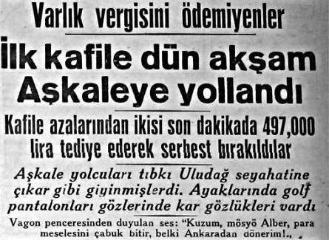
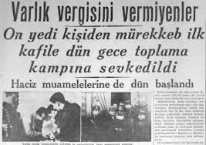
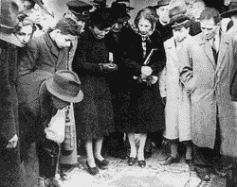
Turkey and The SECOND WORLD WAR
Foreign Policy of Turkey During the Second World War:
Active Neutrality
Domestic Effects of the Second World War:
National Defence Law (1940)
Wealth Tax (1942)

Slide 4
1945-1950: DemocratIzatIon and LIberaIzatIon. InternatIonal Context After the World War II
The defeat of the Axis powers in the Second World War: A victory for democratic values.
Closer relations with the West and USA
Uneasy relationship with Soviet Union

Slide 5

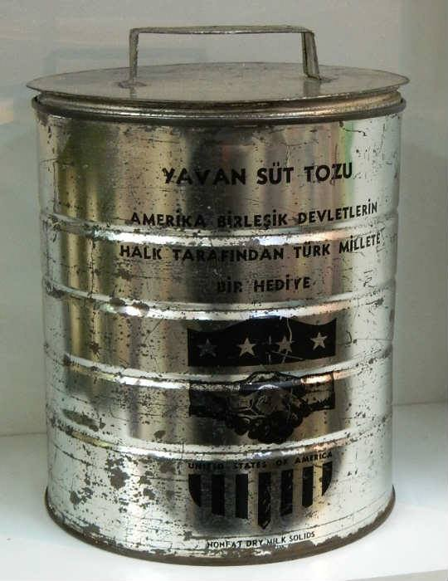
Truman DoctrIne and Marshall Plan
On 12 March 1947, President Truman launched his so-called ‘Truman doctrine’.
In June 1947, the Marshall Plan was put forward. It had three complementary aims: to help the Europeans help themselves; to sustain lucrative export markets for US industry; and to eliminate poverty as a breeding ground for communism.

Slide 6
Domestıc Socıo-Economıc Pressures
İnönü’s opening speech in the parliament in November 1944.
In May 1945, Land Distribution Law
Dörtlü Takrir (Memorandum of the Four): After the law entered into effect, Adnan Menderes, Celâl Bayar, Refik Koraltan and Fuat Köprülü submitted a memorandum to the parliamentary party.
The Demokrat Parti (Democratic Party) was officially registered on 7 January 1946.

Slide 7
1946 ElectIons
Early Elections of 1946
DP won 62 of the 465 seats in the assembly.
There had been massive vote rigging in the 1946 elections.

Slide 8
THE PERIOD BETWEEN 1946-1950: RPP AND DP
1947-12th of July Declaration
Hardliners within the RPP like Recep Peker were eliminated.
At its congress in November 1947, the RPP moved even closer to the DP programme.

Slide 9
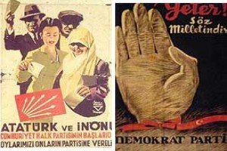
1950 ElectIons
Free and Fair elections.
The turnout was very high, with 80 per cent of the electorate casting its vote.
Democratic Party had campaigned with the slogan “Yeter Söz Milletin” (Enough! Now the people have their say), and had won 53.4 per cent of the vote against the RPP’s 39.8 per cent.
DP received 408 seats in the new parliament against the RPP’s 69.
The RPP did not win a single province in the more developed west of the country.

Slide 10
DemoCrat Party
National Will
“ Democracy is the regime of numbers. In this regime the wishes of the masses are carried out. We, as the responsible ones in power are obliged to take into consideration the wishes of the mass of the people and shot the shouts and criticisms of a handful of intellectuals” Samet Ağaoğlu

Slide 11
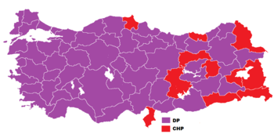
1950 ElectIons

Slide 12
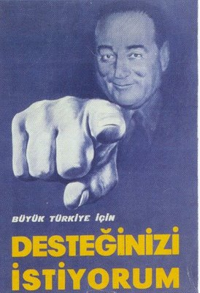
The 1954 electIons: Increased DP majorIty
The DP’s economic success guaranteed it the support of the mass of the population, especially in the countryside.
The central theme of the RPP campaign lacked credibility as it came from a party so closely identified with the authoritarian regime of the past.
On 2 May 1954 the DP increased its share of the vote (from 53.6 to 58.4 per cent), while the RPP share dropped from 39.9 to 35.1 per cent. In the assembly this meant 503 seats for the DP, while the RPP was left with only 31.

Slide 13
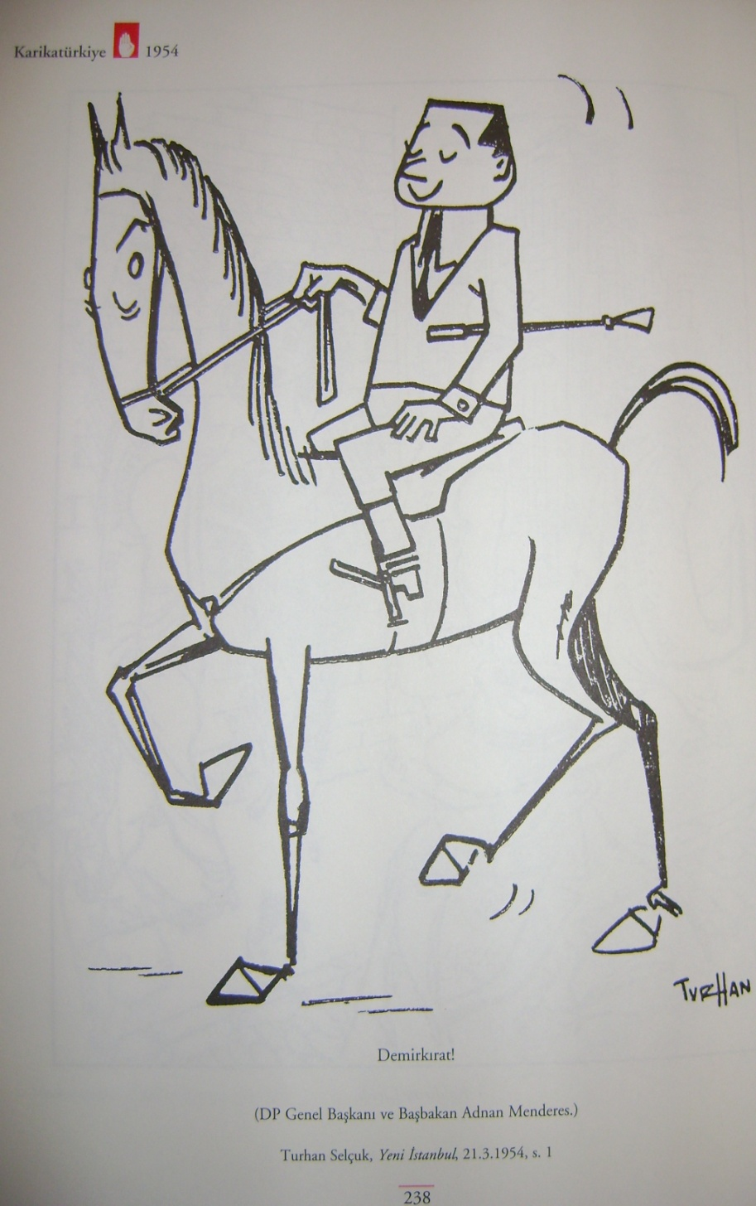
May 1954 ElectIons
DP – 503 seats vs RPP – 31 seats “The elections have clearly revealed how much the citizen like the road I have taken. I used to see your advice on whether aspirin or optalidon as a cure for nerves. Now the people’s lively confidence makes it obvious that there is no further need for such consultations. I am going to have the final word and use aspirin or optalidon as I please.” – Adnan Menderes

Slide 14
EconomIc Developments, 1950-1954: Unprecedented economIc boom
The Democrats had been the most vocal supporters of free-market economics since 1946 and that they implemented liberalization policies with vigor once they were in office.
Under the direction of Menderes, they, for the first time in Turkish history, put the interests of the farmer first, and they continued to do so until the very end.
Supported by large-scale American aid, the progress in these first years was impressive. The credits were used to buy imported machinery. The total number of tractors for example grew from 1750 to more than 30,000 in the years 1948–52.

Slide 15
Reversal of Fortune: DP after 1954
The economic problems accumulate
Increasing trade deficit after the economic boom came to an end in 1954.
Economic growth fell from around 13 per cent to around 4 per cent.
In 1958, the lira was devalued, the debts rescheduled and prices were raised.
By 1960, the total external debt of the country stood at $1.5 billion, a quarter of the GNP.

Slide 16
IncreasIng opposItIon and Democrat Party’s growIng authorItarIanIsm
Early retirement for civil servants
The Right to Prove (İspat Hakkı)
6-7 September Events
1957 Elections
The crumbling of support among intellectuals, members of the bureaucracy and the armed forces.
Tightening of Freedom of the Press and Autonomy of Universities

Slide 17
The fInal years of Menderes
Growing discontent within the military
The issue of secularism
Menderes launched the Vatan Cephesi (Fatherland Front)
In April 1960, Investigatory Committee (Tahkikat Komisyonu)

Slide 18
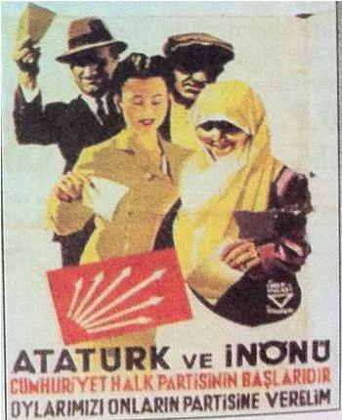


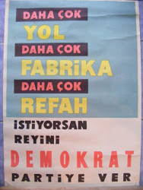
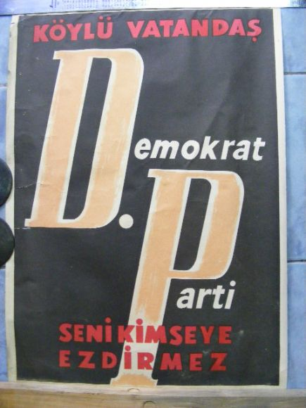
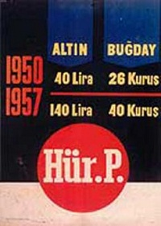



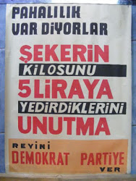
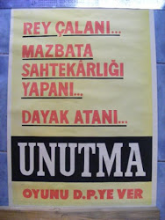
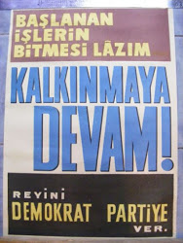
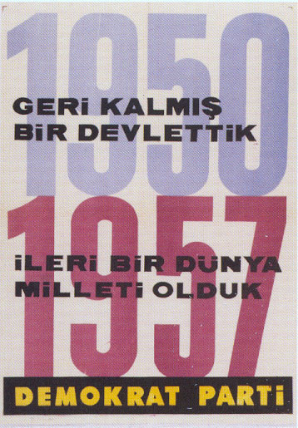

Slide 19
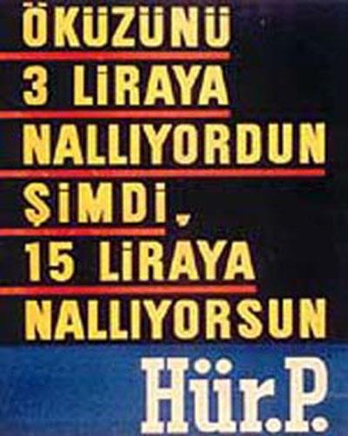


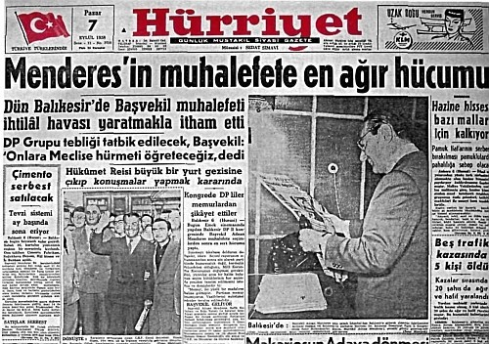

Slide 20
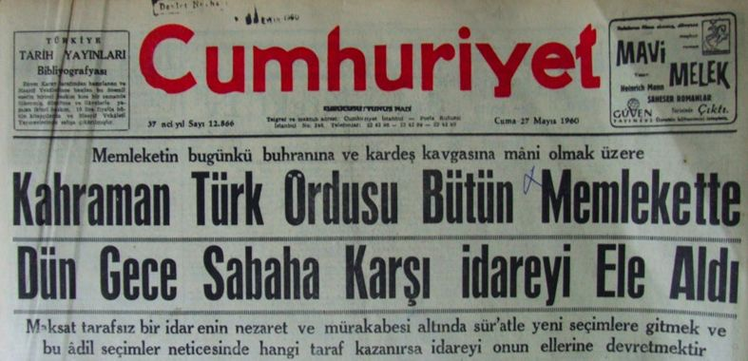
The MILItary Takeover of 27 May 1960
27 May 1960 –Military Coup
The declaration read on the radio by Colonel Alpaslan Türkeş announced that the Turkish armed forces had taken over the administration of the country ‘to prevent fratricide’ and to ‘extricate the parties from the irreconcilable situation into which they had fallen’.
Formation of a ‘National Unity Committee’ (Millî Birlik Komitesi) headed by General Gürsel.

Slide 21
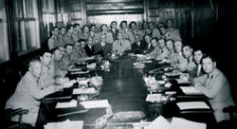
From coup to revolution: the role of the professors
Sıddık Sami Onar and The New Constitution
Factions within the NUC
On 13 November 1960 Cemal Gürsel suddenly announced that the NUC had been disbanded and that a new one had been founded, excluding 14 of the best-known radicals, among them Türkeş.

Slide 22
1961 ConstItutIon
The constitution of 1961 was markedly different from the 1924 constitution.
The main aim of the new constitution was to prevent a power monopoly such as the DP (and the RPP before it) had held, by counterbalancing the national assembly with other institutions.
A second chamber, called the senate (senato), was created and all legislation would have to pass both chambers (with a mechanism to overrule a senate veto with a two-thirds majority in the assembly).
An independent constitutional court was introduced, which could throw out legislation it regarded as unconstitutional and the judiciary.

Slide 23
1961 ConstItutIon AND NEW ELECTION LAW
The universities and the mass media were guaranteed full autonomy.
A full bill of civil liberties was included in the constitution.
The military were given a constitutional role for the first time through the establishment of a National Security Council (Millî Güvenlik Kurulu) mentioned in the constitution.
Under the new election law of May 1961, proportional representation was introduced to lessen the chance of one party holding an overwhelming majority in the assembly.

Slide 24
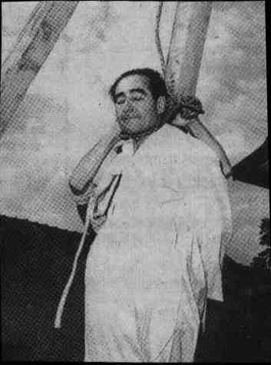
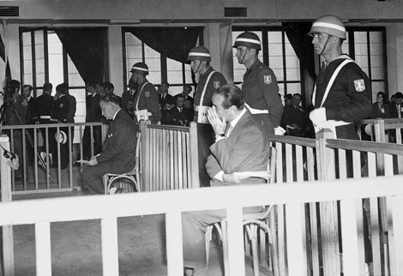
The trIal of the old regIme
Former leaders of the Democratic Party had all been arrested in the aftermath of the coup.
People over 65 years old were not executed.
The members of the tribunal were clearly biased politically against the DP.
The judges made no effort to hide their distaste for the accused.

Slide 25
Return to Democracy, 1961
The referendum on the new constitution on 9 July 1961 was a severe setback for the forces of 27 May: The constitution was accepted with 61.7 against 38.3 per cent of the votes cast.
Parliamentary elections were held on 15 October 1961.
1961-1964: İnönü coalitions.

Slide 26
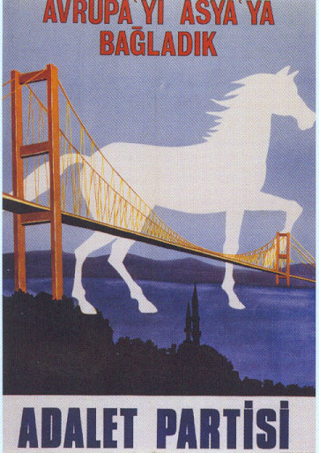
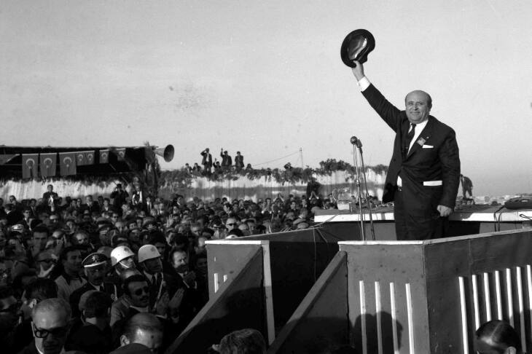
The RIse of Süleyman Demİrel In TurkISH PolItIcs
The landslide victory of Justice Party in the elections of October 1965
High economic growth
Real incomes went up almost continually, by an average of %20 between 1963 and 1969.
Demirel achieved to reconcile the army with rule by civilians.
As a result, however, the armed forces were granted almost complete autonomy, their submission to the authority of the Minister of Defence and the cabinet was no more than a formality.

Slide 27
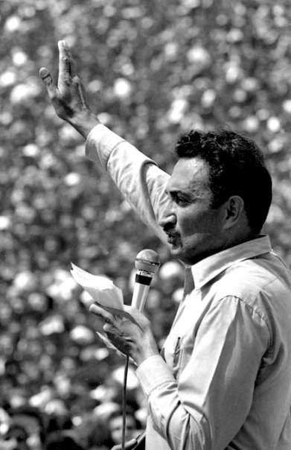
The RepublIcan People’s Party moves left of Centre
The RPP had gone into the 1965 elections with a new manifesto.
Ecevit defined the position of the party as ‘left of centre’ (ortanın solu)
Aiming at a new electoral base.
RPP also strove to compete with the Workers’ Party, something the new slogan was meant to help achieve.

Slide 28


The growth of polITIcal radIcalIsm on the Left
The Rise of Workers Party of Turkey: Lively intellectual debates about all kinds of political and social issues
Debating societies were taken over by student activists of the Workers Party of Turkey and became Fikir Kulüpleri Federasyonu
Doğan Avcıoğlu-Yön dergisi
Soviet invasion of Czechoslovakia caused a split within WPT.
Violent clashes with police and troops during visits by the American Sixth Fleet in July 1968 and February 1969, during which people were killed.

Slide 29
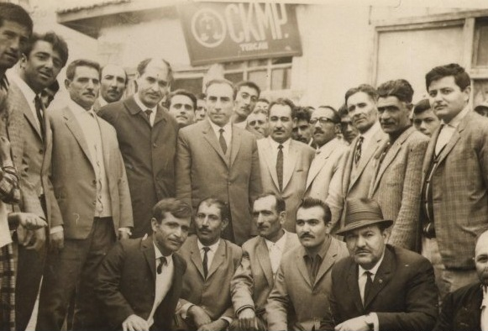
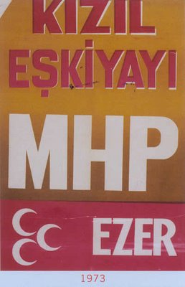
The growth of polItIcal radIcalIsm on the RIght
Conservative Republican Peasants’ Nation Party and Alparslan Türkeş.
‘Hearths of the Ideal’ (Ülkü Ocakları), whose members called themselves Bozkurtlar (Grey Wolves) began a campaign to intimidate leftist students, teachers, publicists, booksellers and, finally, politicians in 1968.

Slide 30
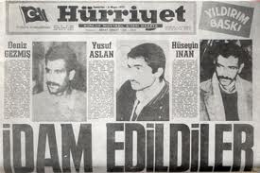
The MILItary UltImatum of 12 March 1971
On 12 March 1971 the Chief of General Staff handed the prime minister a memorandum, which really amounted to an ultimatum by the armed forces. It demanded that a strong and credible government be formed that would be able to end the ‘anarchy’ and carry out reforms ‘in a Kemalist spirit’.
The politicians’ immediate reaction to the ultimatum was negative.
Unlike 1960, it was a ‘coup’ by the high command.
Nihat Erim formed a cabinet, which consisted largely of technocrats from outside the political establishments.
Economic and political demands of the Memorandum.
Deniz Gezmiş, Hüseyin İnan and Yusuf Aslan were executed in 1972.

Slide 31
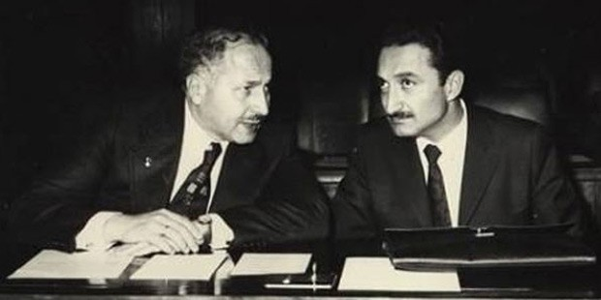
Tumultuous Decade: 1970s
October 1973: first free elections since the memorandum of 1971
Coalition or minority governments continued throughout the decade.
The coalition led by Bülent Ecevit had only been in power for a few months when the Cyprus crisis broke out.

Slide 32
Cyprus CrISIS
On 16 August 1960 Cyprus became an independent republic, with Archbishop Makarios as its first president.
London-Zurich Agreements-Britain, Greece and Turkey
In 1964 President-Archbishop Makarios of Cyprus and his government made moves to limit the autonomy of the Turkish minority. İnönü responded.
Johnson Letter 1964

Slide 33

Cyprus CrIsIs
A coup d’état was made against Makarios in Cyprus.
Ecvit demanded an intervention, based on Turkey’s guaranteur position.
Turkish troops landed in northern Cyprus on 20 July and established a bridgehead around Kyrenia (Girne).
In 1983 a formally independent Turkish Republic of Northern Cyprus (Kuzey Kıbrıs Türk Cumhuriyeti) was proclaimed, though only Turkey recognized it.
The USA’s arm embargo.

Slide 34
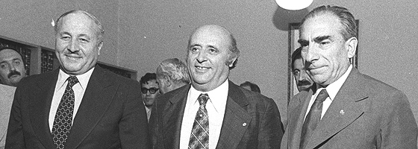
PolITICal sITuatIon IN THE 1970s
The Rise of Ecevit as the National Hero
Ecevit wanted to use his new popularity after Cyprus to gain an absolute majority in early elections and resigned on 16 September 1974.
Nationalist Front Governments (Milliyetçi Cephe Hükümetleri): 1975-1979

Slide 35
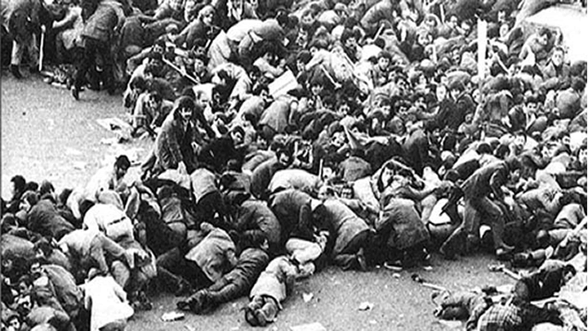
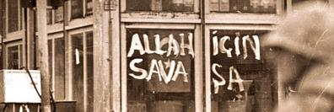
The RISIng TIde of PolItIcal VIolence
The struggle between right and left was an unequal one. The police and the security forces had become the exclusive preserve of Türkeş’s NAP.
The number of victims of political violence rose quickly: from around 230 in 1977 to between 1200 and 1500 two years later.
Bloody 1st of May-1977
Kahramanmaraş events-1978
The paralysis of the political system reached a peak when the assembly became incapable of electing a successor to President Korutürk when his term ended in 1980.

Slide 36
TurkIsh Economy In the 1960s: PlannIng and Import substITUTIon
The creation of State Planning Office (Devlet Planlama Teşkilâtı)
Five Year Development Plans
Planning and two visions of JP and RPP
Import Substituting Industrialization
Growing wealth of the population and increasing demand for consumer goods.

Slide 37
Economy In CrISIs: 1970s
The oil crisis of 1973–74 led to a quadrupling of the price of oil on the international market.
A second oil price shock in 1979–80, two-thirds of Turkey’s foreign currency earnings went to meeting the oil bill.
Desperate Times, Desperate Measures
The National Front coalition governments tried to meet the problem by concluding extremely costly short-term Euro-dollar loans and by printing money.
Imposing import restrictions to conserve precious foreign reserves.
An artificially high rate of exchange to keep the inflation down.

